Slide 1
Case 3 | Statistics and Data Science
Liamo Pennimpede

Slide 2
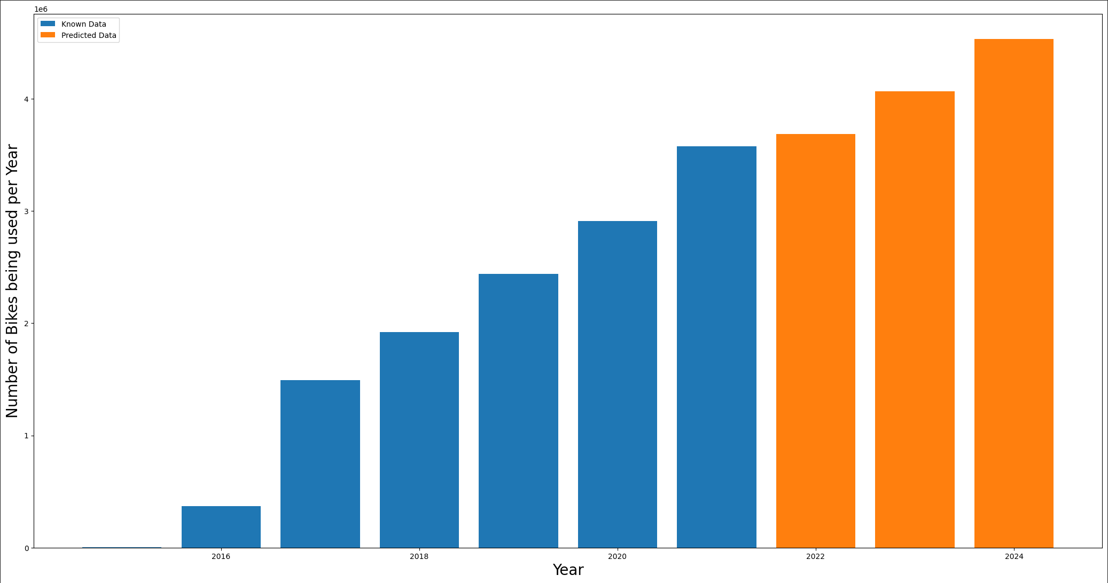
Bike Share Toronto Ridership Analysis
Steps Taken:
Clean the data from excel and format it for simple use
Preprocess the Data to standardize it
Split Data into a training dataset and testing dataset
After achieving a suitable confidence level apply Linear Regression prediction
Source: https://open.toronto.ca/dataset/bike-share-toronto-ridership-data/

Slide 3
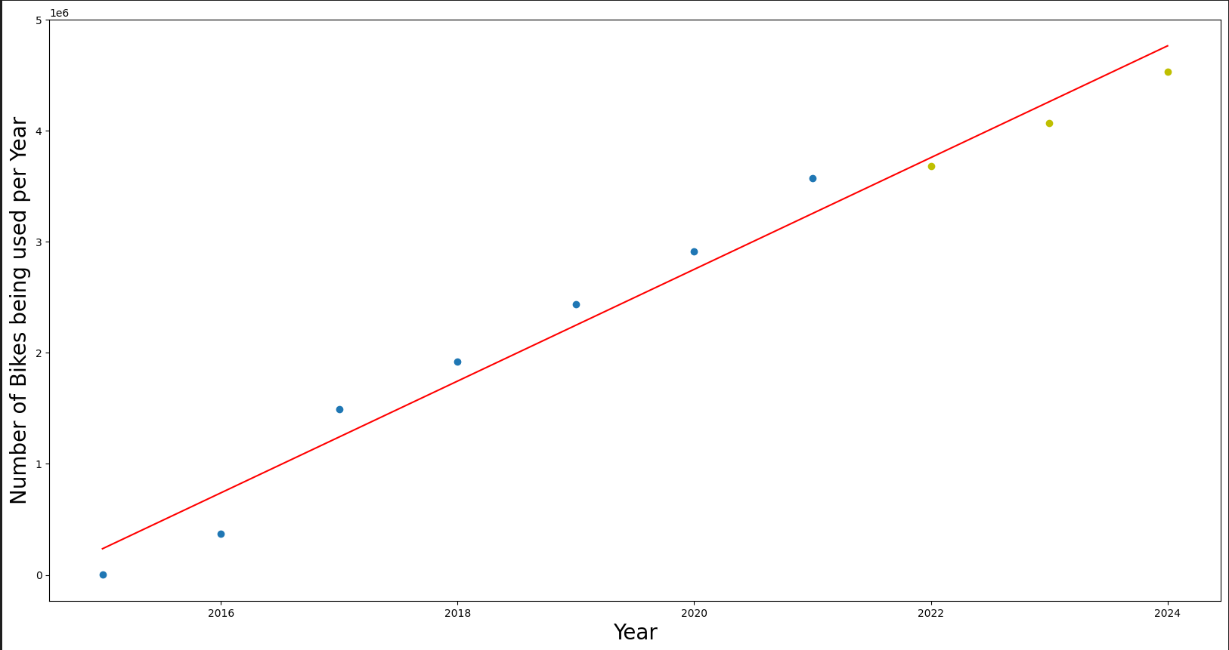
Bike Share Toronto Ridership Analysis
Source: https://open.toronto.ca/dataset/bike-share-toronto-ridership-data/

Slide 4
Analysis based on the year 2022
Number of Bikes Used So Far in 2022
Number of Bikes Predicted to Used in
2022
3017662
3683232
Which means that 665570 or more have to be used in the next 4 months for the model to be correct!

Slide 5
Analysis based on the year 2022
Number of bikes used between Janauary and April: 521633
Number of bikes used between May and August: 2496029
Average number of uses during the two first thirds of the year: 1508831
Therefore, the model is underestimating how many people would use bikes!
(The number of uses may drop when the winter months start!)

Slide 6
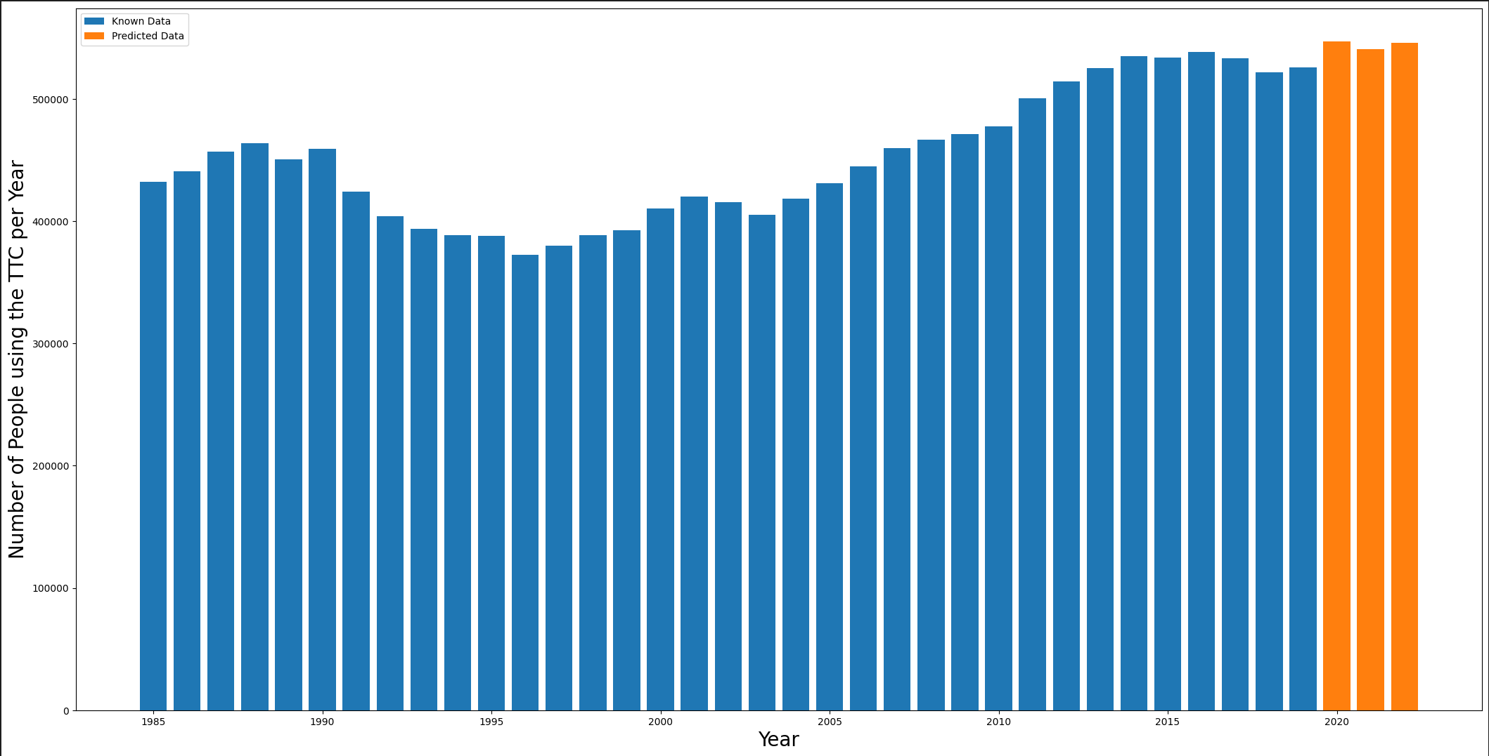
Number of People Using the TTC per year
Steps Taken:
Clean the data from excel and format it for simple use
Preprocess the Data to standardize it
Split Data into a training dataset and testing dataset
After achieving a suitable confidence level apply Linear Regression prediction
Source: https://open.toronto.ca/dataset/ttc-ridership-analysis/

